Slide 1

General Information About Web Page
We used PHP-3 as a coding Language.
CSS, Script, and Keyframe to design and give animation to web Page.
MYSQL is used for store Data in Database.

Slide 2

ScreenShot from WebPage

Slide 3
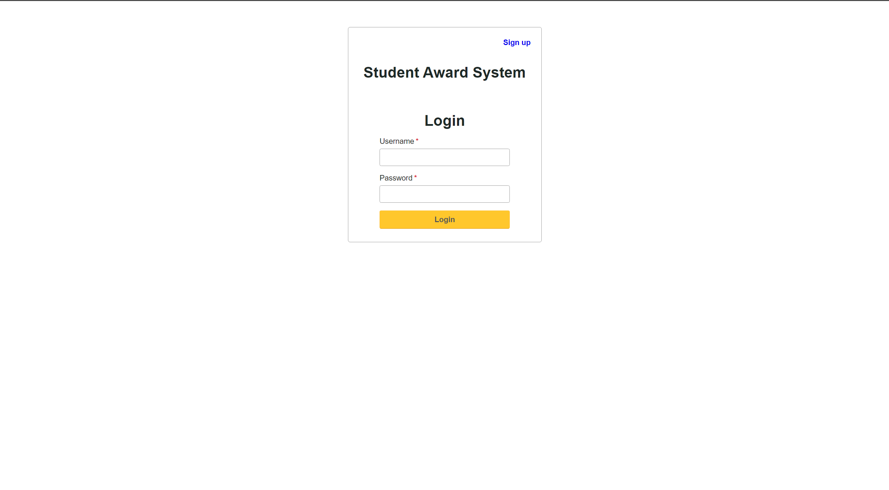
Login Page

Slide 4
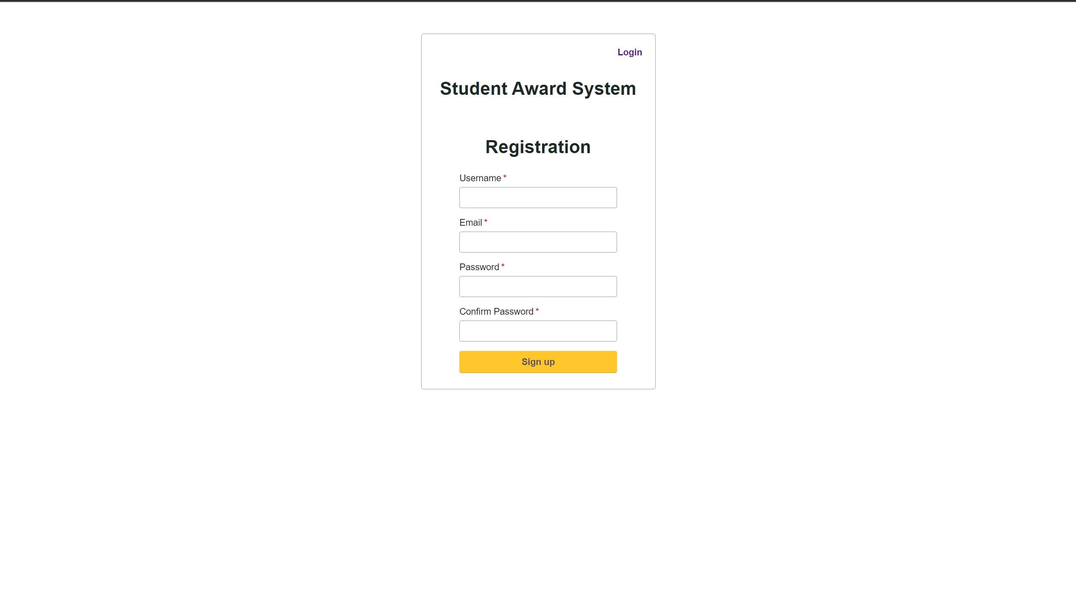
Registration Page

Slide 5

Dashboard and Header Part

Slide 6
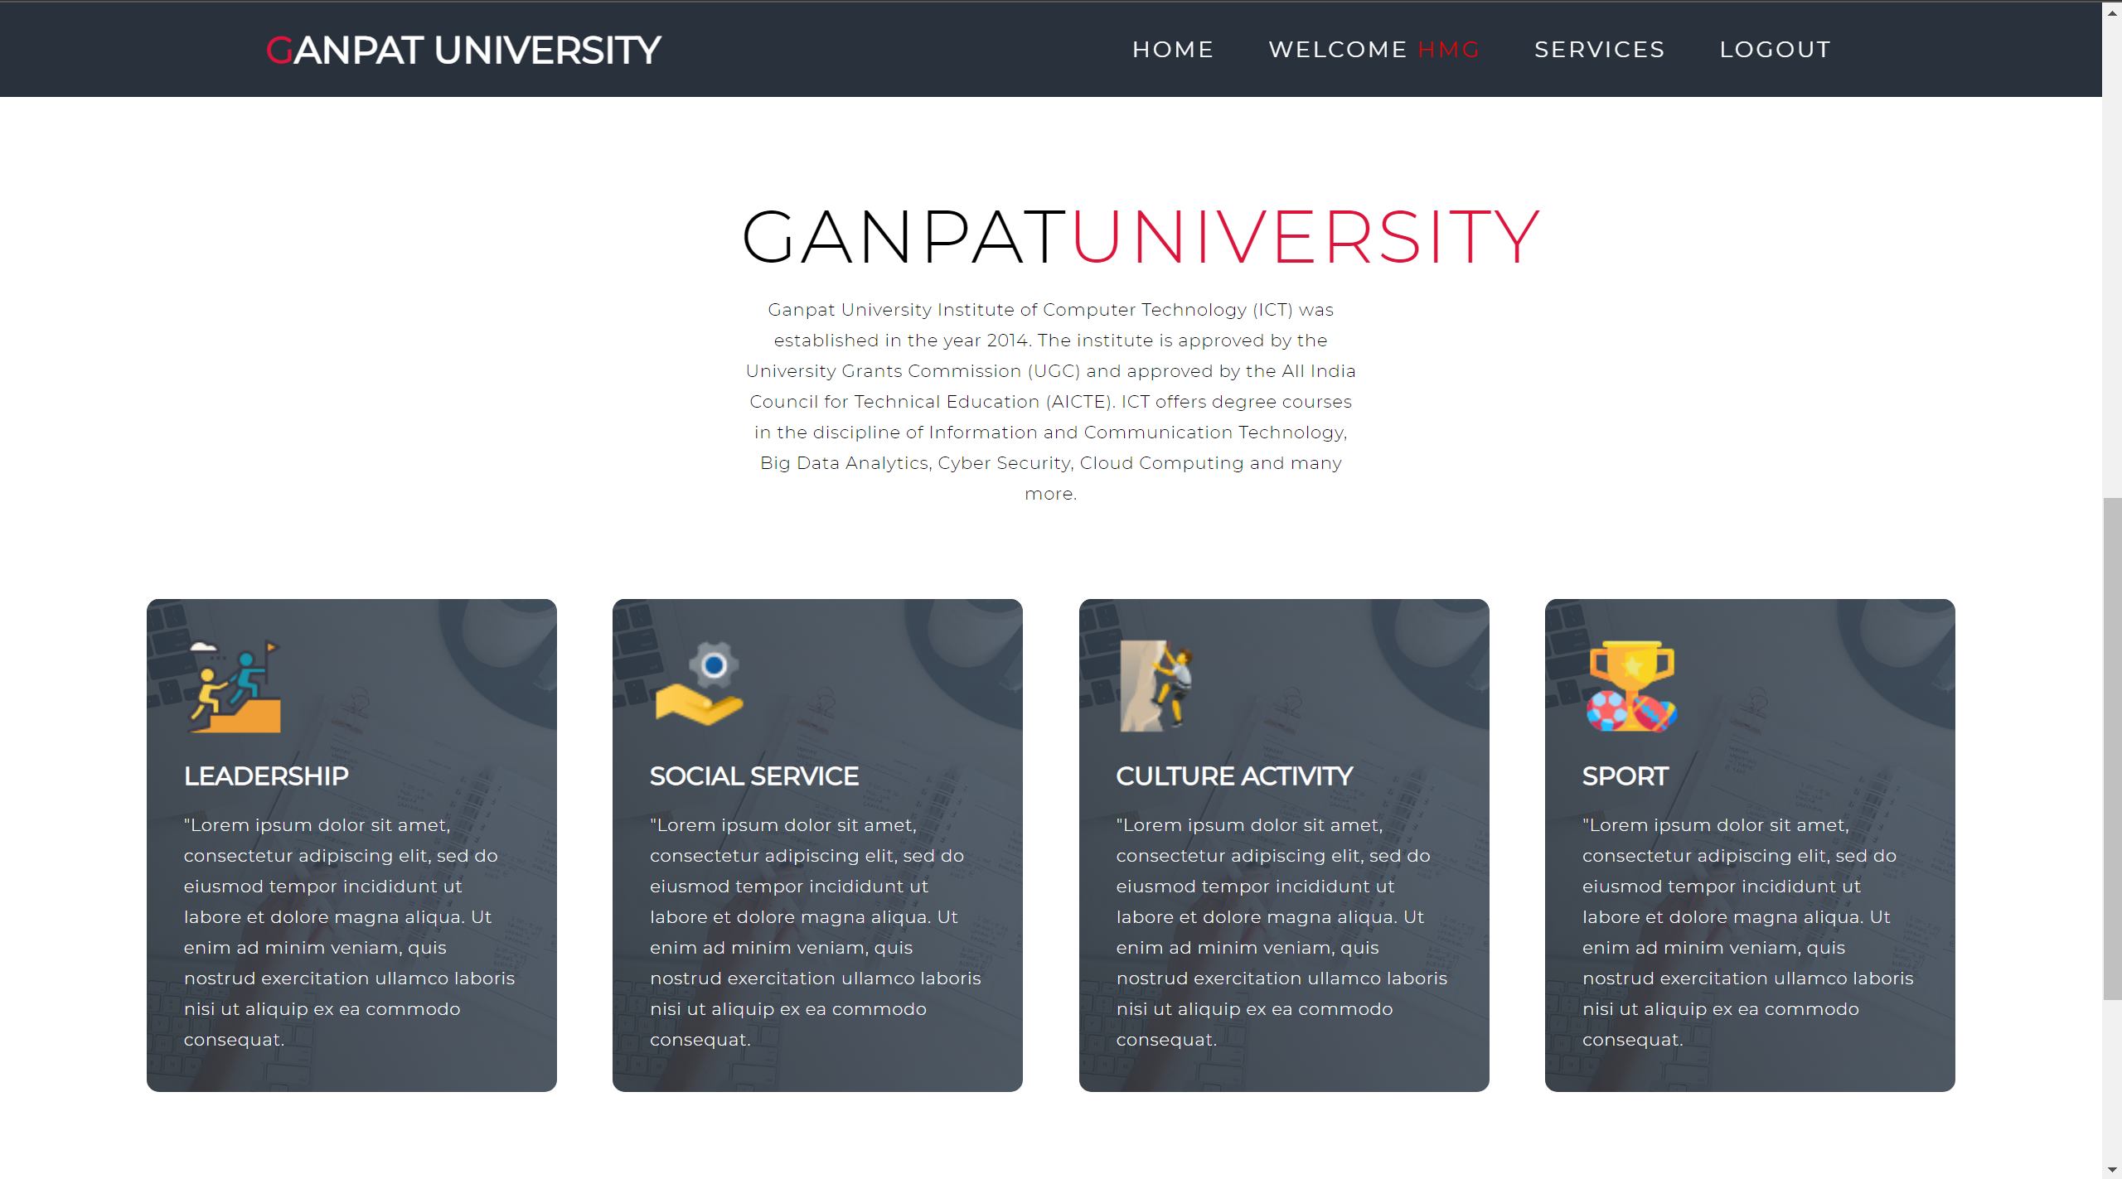
Body Part

Slide 7
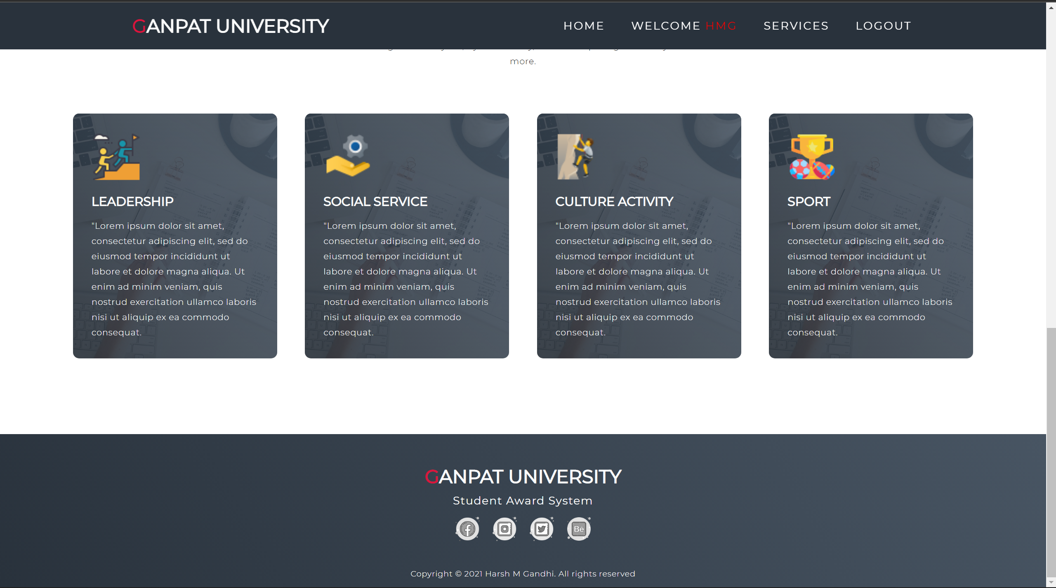
Footer Part

Slide 8
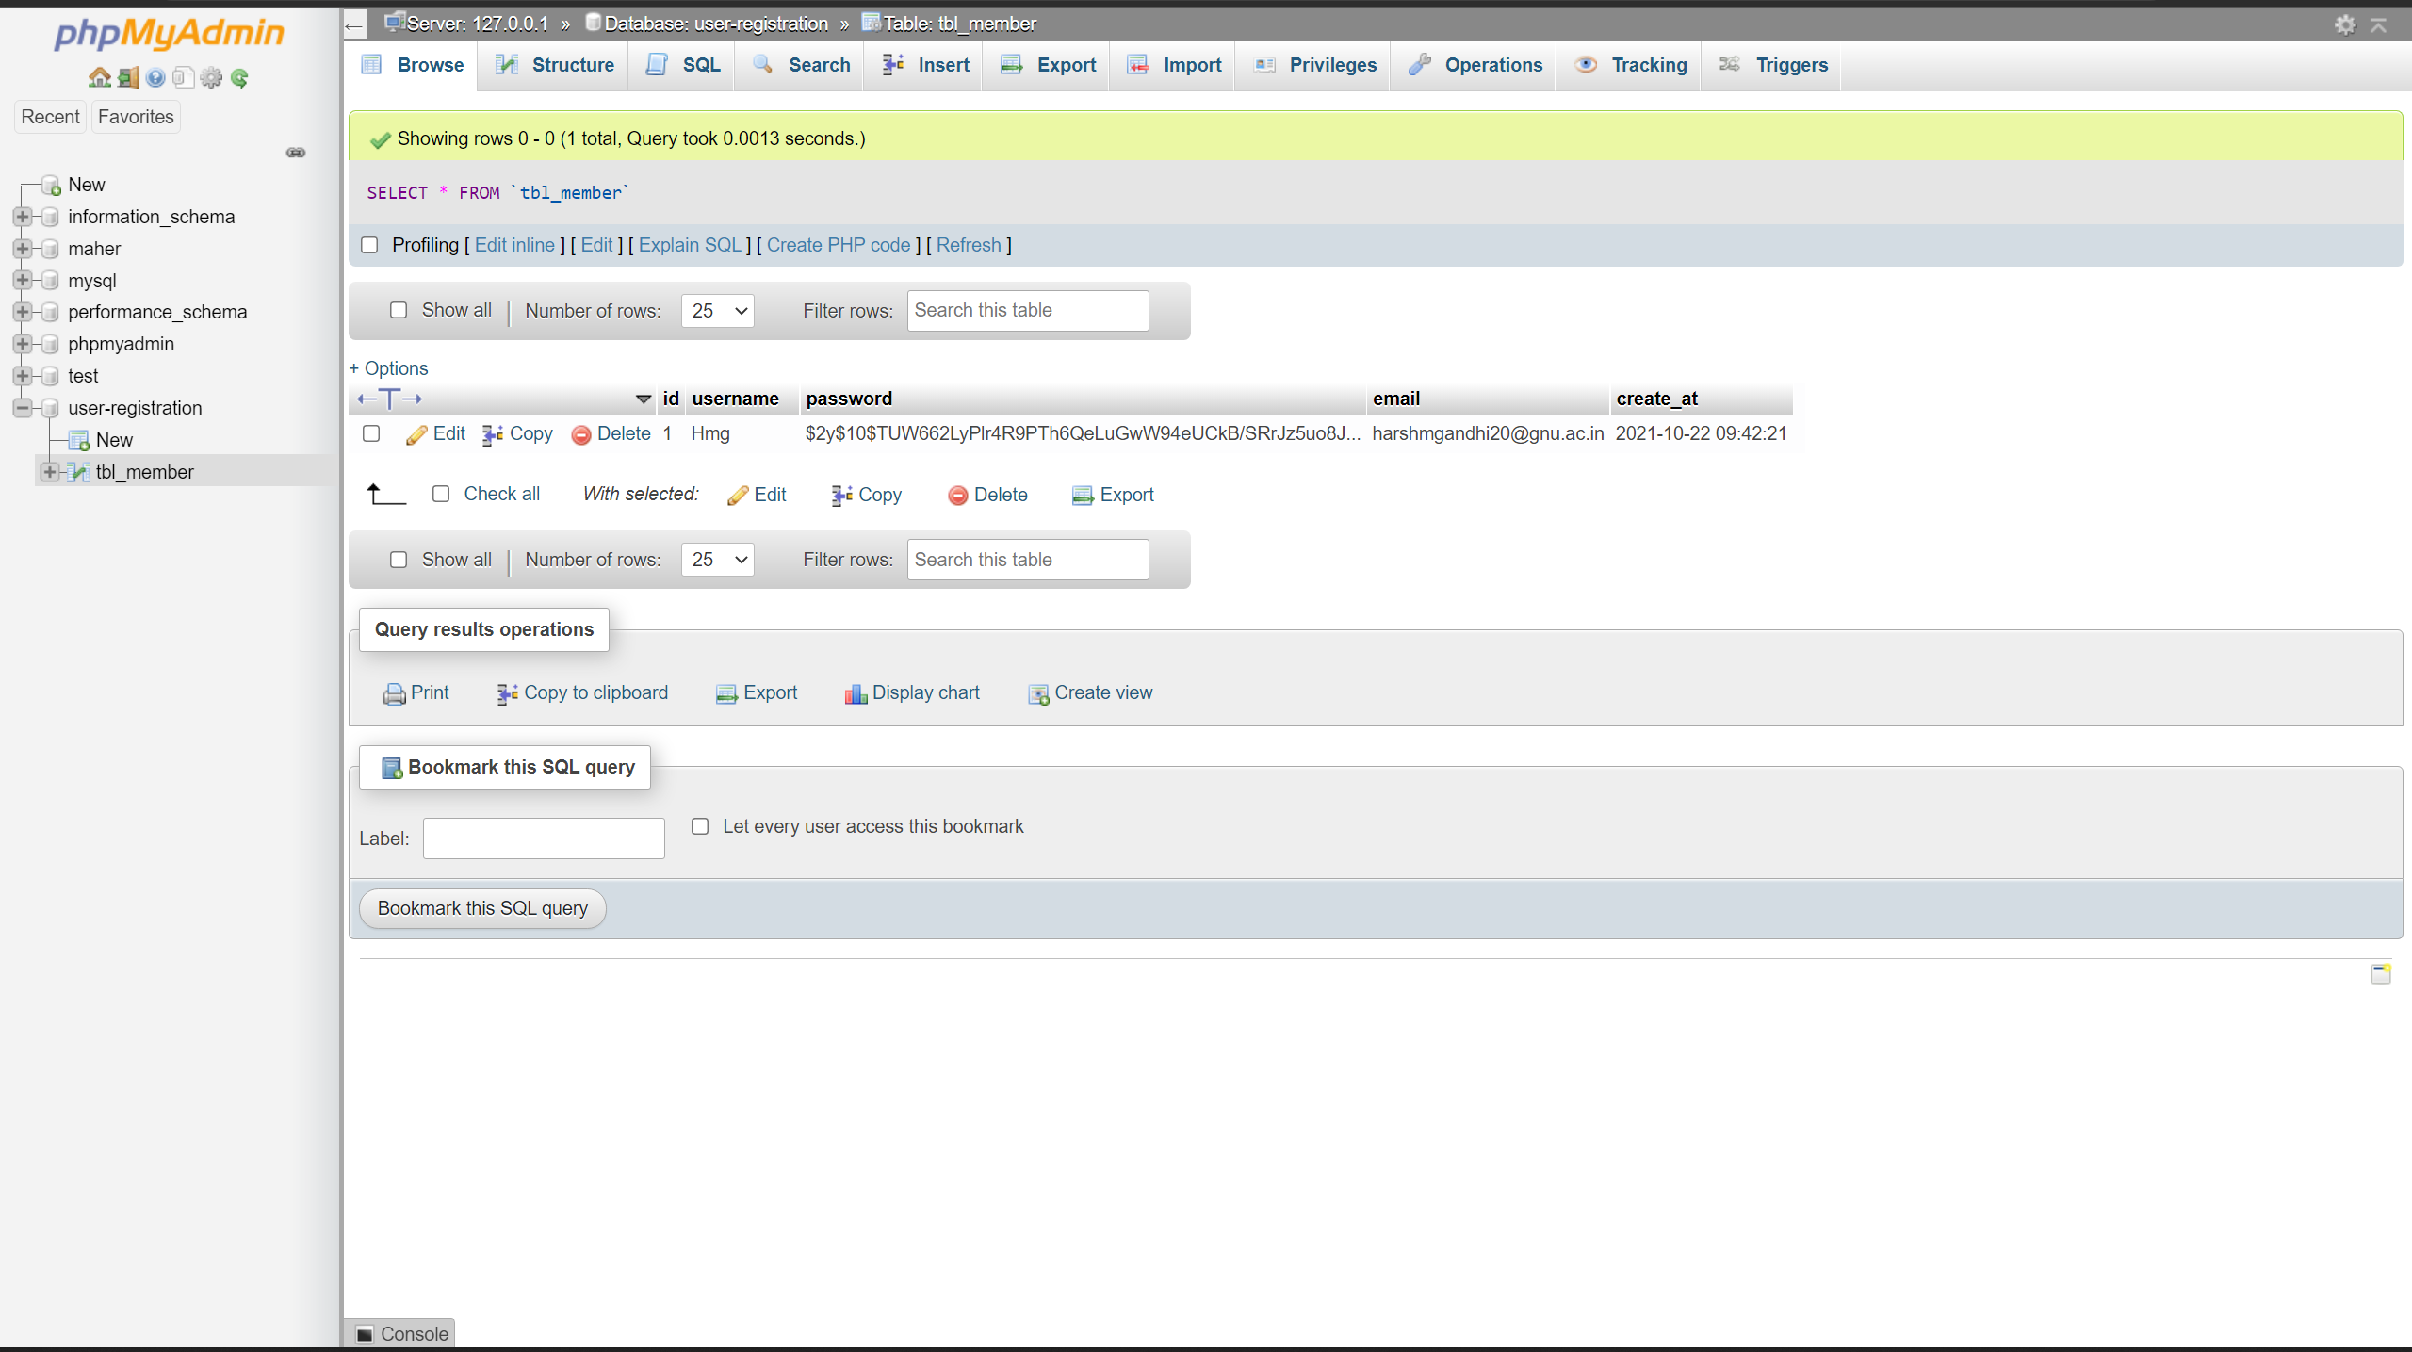
Data Base

Slide 9

Thank You

